Slide 1
Economics
Week #3

Slide 2
Topics of Week #3
Markets
Demand*
Supply*
Demand and Supply Analysis*
Graphs of Shifts*
"*" Indicates the most important topics.
Mateer and Coppock: Chapter #3

Slide 3
Markets
Firms
Supply goods and service
Consumers
Want to purchase goods supplied by firms.
Exchange happens
Through prices established in markets.
Supply or demand factors can change the market price.
Notes:
Supply and Demand—These words are consistently used by economists when describing how the market economy functions. Businesses of all sizes, from small specialty shops to the largest corporations, compete to supply customers with what they demand. Adam Smith, the founder of modern economics, said this best: "It is not from the benevolence of the butcher, the brewer, or the baker that we expect our dinner, but from their regard to their own self-interest." Producers try to earn a living by selling products that buyers want. Consumers are self-interested as well; they must decide how to use their money to select the goods that they need or want the most. This process, which Adam Smith termed the "invisible hand," guides resources toward their highest-valued use. It does this by encouraging the production of goods that buyers value and providing a mechanism, prices, that transfers them to consumers.

Slide 4


Markets
Sellers and buyers come together to form a market.
Markets exist whenever goods and services are exchanged.
Doesn't have to be a physical place.
Notes:
Markets exist whenever goods and services are exchanged. Some markets are online, and others can be found in traditional "brick and mortar" stores.

Slide 5
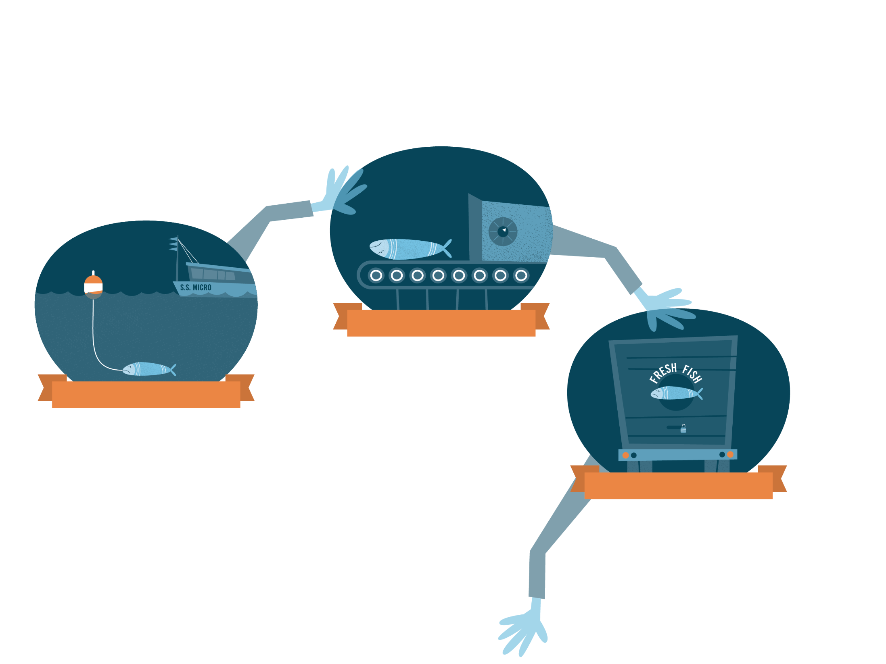
The Invisible Hand
SNAPSHOT
The trucker cares only about getting paid once the delivery is made. What's in the back of the rig is not important.
2. PROCESSED
1. CAUGHT
The fishing boat captain trolls the waters to earn an income. She doesn't care what happens to the fish so long as she gets paid when the boat offloads at the dock.
3. SHIPPED
Notes:
Why is the fish you want for dinner available in the store? It is because at each point in the economy's supply chain, the participants are concerned with their own profit. The process starts with the boat that catches the fish, then moves to the processing facility, to the truck, and finally to the store where the clerk sells the fish to you and me. At each step, the participant works to deliver the fish because they are acting in their own self-interest—matching supply to demand as if guided by an invisible hand.
REVIEW QUESTIONS
What if someone in the supply chain is not allowed to earn a profit? How will this affect their actions and the supply chain as a whole?
If fewer Alaskan salmon are caught, what will happen the price of salmon?

Slide 6
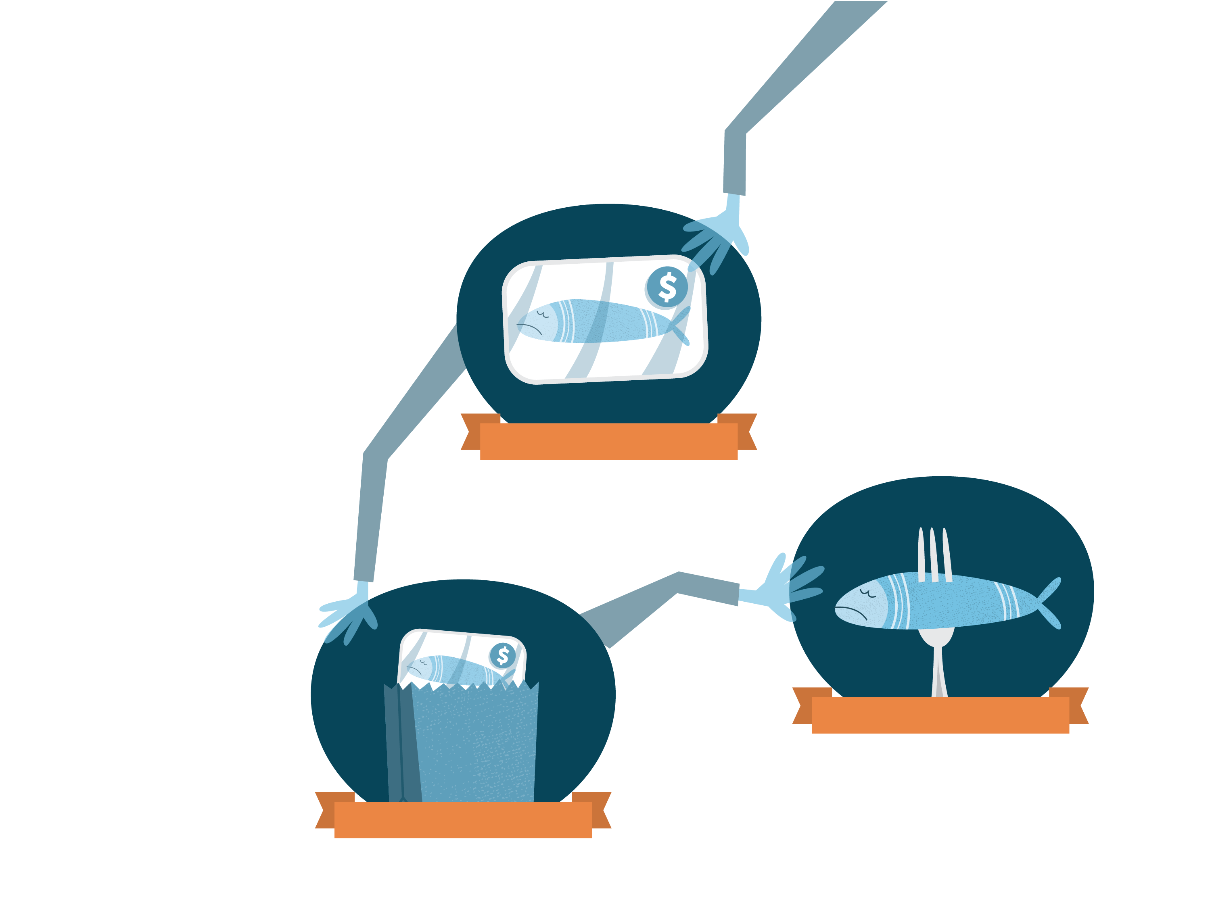
The Invisible Hand
SNAPSHOT
The consumers care about freshness and price. They don't care to know the name of the fishing captain or trucker that brought the fish to the store for them to enjoy.
4. DISPLAYED
6. EATEN
5. PURCHASED
Notes:
Why is the fish you want for dinner available in the store? It is because at each point in the economy's supply chain, the participants are concerned with their own profit. The process starts with the boat that catches the fish, then moves to the processing facility, to the truck, and finally to the store where the clerk sells the fish to you and me. At each step, the participant works to deliver the fish because they are acting in their own self-interest—matching supply to demand as if guided by an invisible hand.
REVIEW QUESTIONS
What if someone in the supply chain is not allowed to earn a profit? How will this affect their actions and the supply chain as a whole?
If fewer Alaskan salmon are caught, what will happen the price of salmon?

Slide 7
Demand
Quantity demanded
The amount of a good purchased at a given price.
Law of demand
All other things equal, there is an inverse relationship between price and quantity demanded.
Inverse: two variables move in opposite directions.
Notes:
Inverse relationship between price and quantity demanded:
If price goes up, quantity demanded decreases;
If price goes down, quantity demanded increases.
Recall that this is all other things equal (ceteris paribus). Other things can affect consumption as well, not just price.

Slide 8
Demand
Demand schedule
Table showing the relationship between price and quantity demanded.
Demand curve
Graph of the relationship between price and quantity demanded.
Market demand
Horizontal sum of all individual quantities demanded by each buyer in the market at each price.

Slide 9
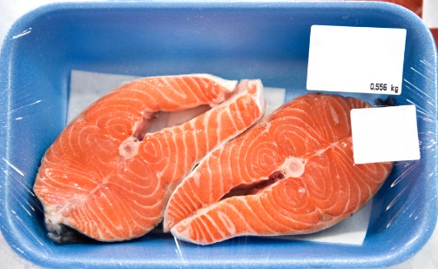
Demand
Meredith's Demand Schedule for Salmon Fillets
Price of Salmon | Salmon Fillets Demanded
$20.00 | 0
$17.50 | 1
$15.00 | 2
$12.50 | 3
$10.00 | 4
$ 7.50 | 5
$ 5.00 | 6
$ 2.50 | 7
$ 0.00 | 8
Higher price
Lower quantity demanded
Higher quantity demanded
Lower price
Notes:
The table shows a hypothetical demand schedule for salmon fillets for Meredith. When the price is $20 or more, Meredith will not purchase any salmon. However, below $20 the amount that Meredith purchases is inversely related to the price. For instance, at a price of $10, Meredith's quantity demanded is 4 fillets per month. If the price rises to $12.50 per serving, she demands 3 fillets. Every time the price increases, Meredith buys less salmon. In contrast, every time the price falls, she buys more. If the price falls to zero, salmon becomes free, and Meredith would want 8 fillets. She does not want an unlimited amount of salmon because she would grow tired of eating the same thing.

Slide 10
Demand Curve
Notes:
The demand curve is a graph of the relationship between the prices on the demand schedule and the quantity demanded at those prices.
The relationship between price and the quantity demanded produces a downward-sloping curve. As the price rises from $0 to $20, along the y axis, the quantity demanded decreases from 8 to 0 fillets, along the x axis. The demand curve connects all of the data points in the table into one continuous curve. Therefore, when you observe a demand curve, you are looking at a visual representation of a demand schedule. (For simplicity, the demand "curve" is often drawn as a straight line.)

Slide 11
Market Demand
Price of Salmon |  | Meredith's Demand |  | Derek's Demand |  | Market Demand
$20.00 |  | 0 |  | 0 |  | 0
$17.50 |  | 1 |  | 0 |  | 1
$15.00 |  | 2 |  | 1 |  | 3
$12.50 |  | 3 |  | 1 |  | 4
$10.00 |  | 4 |  | 2 |  | 6
$ 7.50 |  | 5 |  | 2 |  | 7
$ 5.00 |  | 6 |  | 3 |  | 9
$ 2.50 |  | 7 |  | 3 |  | 10
$ 0.00 |  | 8 |  | 4 |  | 12
+
=
Notes:
The market demand is the sum of all the individual quantities demanded by each buyer in the market at each price. At the fish market, the typical day witnesses over 100 individuals buying salmon. However, to make our analysis simpler, assume that our market consists of only two buyers, Derek and Meredith.

Slide 12
Market Demand
Notes:
The figure shows individual demand schedules for the people in this market, a combined market demand schedule, and the corresponding graphs. At a price of $10, Derek, who is Meredith's coworker, buys 2 salmon fillets a month, while Meredith buys 4 fillets. To determine the market demand curve, we add Derek's 2 fillets to Meredith's 4 for a total of 6.

Slide 13
Shifts in Demand
Movement along a demand curve
Caused by a change in the price of the good.
Inverse relationship between price and quantity demanded.
Shift in demand
Caused by changes in non-price factors.
Entire demand curve will shift to the left or right.
Notes:
This is a very important distinction!
A movement along a demand curve is when we have just a single demand curve, but the price of the good changes. We move from point A to point B along the same curve. We slide up and left OR down and right along the curve.
A shift occurs as the result of a change in something OTHER than the price. We will list these determinants in a little bit.

Slide 14
Shifts in Demand
Notes:
Suppose that the government issues a nationwide safety warning that cautions against eating cantaloupe because of a recent discovery of contamination in some cantaloupe. The government warning would cause consumers to buy less cantaloupe at any given price and overall demand will decline. Looking at the figure, we see that an overall decline in demand will cause the entire demand curve to shift to the left of the original curve, from D₁ to D₂. People want to buy less at ANY PRICE. They are buying less even though the price didn't change!
What about when a variable causes demand to increase? Suppose that the press has just announced the results of a medical study indicating that cantaloupe contains a natural substance that lowers cholesterol. Because of the newly discovered health benefits of cantaloupe, overall demand for it would increase. This increase in demand would shift the demand to the right from D₁ to D₃.

Slide 15
Graphical Summary of Demand Movement vs. Shift
The next few slides give a summary of the possible movements and shift that we could see when considering demand.

Slide 16
Increase in Quantity Demanded
P
Caused by price decrease
Move from point A to point B
Movement along a demand curve
Price↓ Q_{d}↑
A
$12
B
$10
D
7
8
Q

Slide 17
Decrease in Quantity Demanded
P
Caused by price increase
Move from point A to point B
Movement along a demand curve
Price↑ Q_{d}↓
B
$50
A
$30
D
4
6
Q

Slide 18
Increase in Demand
Caused by non-price factors
Entire demand curve shifts to the right.
Willing to buy more at ANY price
P
D₁
D₂
Q

Slide 19
Decrease in Demand
Caused by non-price factors
Entire demand curve shifts to the left.
Willing to buy less at ANY price
P
D₂
D₁
Q

Slide 20
Demand Shifters
1. Changes in income
Normal good
Good in which we buy more of when we get more income.
Direct relationship between income and demand
Inferior good
Good in which we buy less of when we get more income.
Inverse relationship between income and demand
Notes:
So we've seen the graphs. It's time to discuss what could CAUSE a demand shift to occur.
When your income goes up, it improves your purchasing power. Assuming that prices are steady, individuals with more purchasing power are able to buy more of what they want. In this context, it is useful to identify two types of goods: normal and inferior. A consumer will buy more of a normal good if the consumer's income goes up.
A restaurant dinner is a normal good since increased income makes going out more affordable. When people have more money to spend, the demand for restaurant dinners increases and the demand curve shifts to the right. Similarly, decreases in income will diminish demand and shift the demand curve to the left. For most people, this is intuitive since it is human nature to want more "good stuff." More income implies the ability to buy additional goods and services. Likewise, less income means that you can't afford to buy as much as you did before.
When the consumer's income goes up, holding other things constant, the consumer will buy less of an inferior good. An inferior good is a product that is considered of lesser quality by consumers. Examples include used cars as opposed to new cars, rooms in boarding houses as opposed to your own apartment or house, and tuna fish as opposed to filet mignon. As income goes up, consumers buy less of an inferior good because they can afford something better.

Slide 21


Normal and Inferior Goods
Normal Goods
Inferior Goods
Steak
Housing
Laptop
TV
Sit-down restaurant meals
Name-brand clothing
Canned meat, SPAM
Ramen
Mac'n'cheese
Store-brand goods
Secondhand clothing
Notes:
Most goods we buy are normal goods.
Often, we can think of goods being normal and inferior in relation to other goods. For example, ground beef might be inferior to steak.

Slide 22
Demand Shifters
2. Price of related goods
Complements
Two goods used together.
Inverse relationship between the price of good X and demand for good Y
Substitutes
Goods that can be used in place of each other.
Direct relationship between the price of good X and demand for good Y
Notes:
Goods do not exist isolated from other goods. Goods can be related to other goods.
Complements are two goods used together. When the price of a complementary good rises, the demand for the related goes down.
Substitutes are two goods that are used in place of one another. When the price of a substitute good rises, the demand for the related good goes up.
Consider this pair of complements: color ink cartridges and photo paper. When the price of a complementary good (ink cartridges) rises, the quantity demanded of that good (ink cartridges) goes down, and the demand for the related good (photo paper) also goes down, since the total price of purchasing the items together increases.
Substitute goods work the opposite way. When the price of a substitute good increases, the demand for the alternative good increases. For example, the demand for Microsoft's Xbox will increase if the price of the Nintendo Wii goes up, assuming the price of the Xbox remains unchanged.

Slide 23
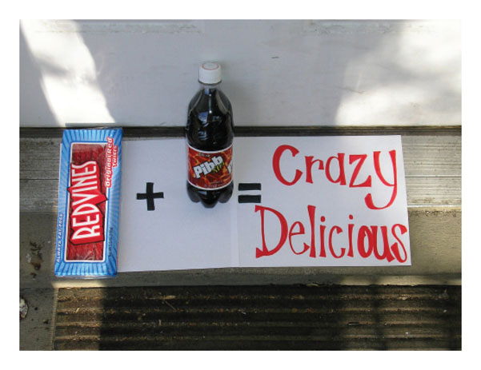
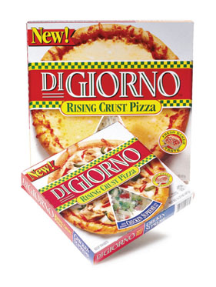

Substitutes and Complements in Consumption
Complements
Substitutes
Biscuits and gravy
Milk and cereal
Printers and toner
Peanut butter and jelly
Whiskey and Coke
Coke and Pepsi
Snickers and Milky Way
Butter and margarine
Pizza Hut and Dominos
Various items in the store with multiple brands
Notes:
Picture: Apparently some people think Red Vines and Mr. Pibb are great complements.

Slide 24
Demand Shifters
3. Changes in Tastes and Preferences
A good may become more fashionable or may come into season.
New style becomes popular
Demand increases (shifts right) as a result.
A good may go out of style or out of season.
Demand decreases (shifts left).
Lower demand for frozen pizza in summer
New information about a good
Can change tastes for better or worse.
Notes:
Economists like to be able to explain all the factors that cause a price change or a shift in demand. Changes in "tastes and preferences" is sometimes used as a "catch-all" category. If an economist can explain that 90% of a consumption change is caused by changes in income and prices of other goods, he may state that the final unexplained 10% may be due to changes in tastes and preferences, which are harder to empirically measure.
Better information about the goods and services that we buy is one way that tastes and preferences can change. We have already seen examples of changes in preferences resulting from information in our example of salmon. Contamination caused a decrease in demand because people no longer cared to eat the fish. On the other hand, if people learn that eating salmon lowers cholesterol, their preference for the fish will go up.

Slide 25
Demand Shifters
4. Future expectations
Our consumption today may depend on what we think the price may be tomorrow.
5. Number of buyers
Recall the market demand curve
More individual buyers means more market demand.
Aging, immigration, war, and birth rates can affect the number of buyers for various goods.
Notes:
Future Expectations
Ask the students if they (or a friend) works at a gas station. If they have "inside information" and know that the price of gas will go down 50 cents next week, will you still buy gas today? Or will you wait?
Number of Buyers
Recall that the market demand curve is the sum of all individual demand curves. Therefore, another way for the market demand to increase is when more individual buyers enter the market. In the United States, we add 3 million people each year to our population. All of those new people have needs and wants like the rest of us. Collectively, they add about 1% to the overall size of many existing markets on an annual basis.

Slide 26
Multiple Market Effects
Goods are often related
Substitutes and complements
This means that one economic event
Can affect multiple markets.
Consider an increase in the price of peanut butter
This will affect the demand for peanut butter and the demand for jelly, but in different ways!
Notes:
Goods are not isolated in some sort of single-market vacuum. A change in the price of one good can affect it and other goods as well. However, the effects will be different!

Slide 27
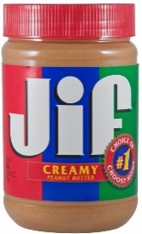
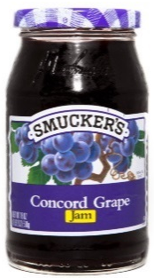
Multiple Market Effects
Event: price of peanut butter increases.
Peanut butter:
Movement along the demand curve
Jelly:
A shift in demand
P
P
B
$4
A
$3
D
D₂
D₁
2
4
Q
Q
Notes:
When the price of peanut butter increases, there is a decrease in the quantity demanded for peanut butter (a movement along the peanut butter demand curve). This is the first law of demand.
Remember also that peanut butter and jelly are complements. Since we are consuming less peanut butter, we consume less jelly also, even though the price of jelly didn't change. The demand for jelly decreases (jelly demand curve shifts inward).

Slide 28
Practice What You Know
Oreos
P
Event:
The price of Oreos falls.
A
$3
B
$2
D
4
5
Q
Notes:
Explanation: Move from point A to point B.
This is an increase in quantity demanded.
Movement along a demand curve.
Price↓ Qd↑

Slide 29
Practice What You Know
Movie Tickets
P
Event:
The price of movie tickets increases.
B
$20
A
$15
D
2
3
Q
Notes:
Explanation: Move from point A to point B.
This is a decrease in quantity demanded.
Movement along a demand curve.
Price↑ Qd↓

Slide 30
Practice What You Know
Big Macs
Event:
The price of a Burger King Whopper falls.
P
D₁
D₂
Q
Notes:
Explanation:
Substitutes. Price of a substitute good fell, so my demand for the Big Mac decreased.
Whoppers are cheaper? I buy more Whoppers and less Big Macs!
This is a shift in demand for Big Macs.

Slide 31
Practice What You Know
Steak Dinners
Event:
You get a promotion and pay raise at your job.
P
D₁
D₂
Q
Notes:
Explanation:
Income. Steak is a normal good. More money means a higher demand for steak.

Slide 32
Practice What You Know
Sam's Club Soda
Event:
You get a promotion and pay raise at your job.
P
D₁
D₂
Q
Notes:
Note that this is the SAME event from the last slide, but we are examining a DIFFERENT good.
Explanation:
Income. Sam's Club soda is an inferior good. More income means the demand falls for the inferior good.
If I buy less Sam's Club sida, I might buy MORE of a NORMAL good, such as Pepsi.

Slide 33
Practice What You Know
Pizza
Event:
The price of your favorite beverage falls.
P
D₁
D₂
Q
Notes:
Explanation:
Complements. Pizza is a great complement to your favorite beverage.
More beverages consumed → more pizza consumed, even though the price of pizza didn't change!

Slide 34
Practice What You Know
Old men's demand for oranges
Event:
Doctors discover that oranges cure baldness.
P
D1
D2
Q
Notes:
Explanation:
Tastes and Preferences. New information is known about health benefits. They simply want the good more. Demand increases.
This slide also illustrates that we can narrowly define a market if we want. Sometimes, we focus on a narrow demographic of individuals when studying consumption.

Slide 35

Practice What You Know
The following three questions are considering the market for the same good.
The good in question is PEPSI.
We are considering:
Change in quantity demanded (movement), and
Change in demand (shift).

Slide 36
Practice What You Know
Assume you like Pepsi, and your income increases.
The demand for Pepsi increases.
The demand for Pepsi decreases.
The quantity demanded for Pepsi increases.
The quantity demanded for Pepsi decreases.
Notes:
Normal good—outward SHIFT in demand.

Slide 37
Practice What You Know
Assume the price of Pepsi decreases.
The demand for Pepsi increases.
The demand for Pepsi decreases.
The quantity demanded for Pepsi increases.
The quantity demanded for Pepsi decreases.
Notes:
Movement along a demand curve. Movement down and to the right.

Slide 38
Practice What You Know
Assume the price of Coke decreases.
The demand for Pepsi increases.
The demand for Pepsi decreases.
The quantity demanded for Pepsi increases.
The quantity demanded for Pepsi decreases.
Notes:
Coke gets cheaper, so we buy more Coke. If we buy more Coke, we buy less Pepsi.

Slide 39
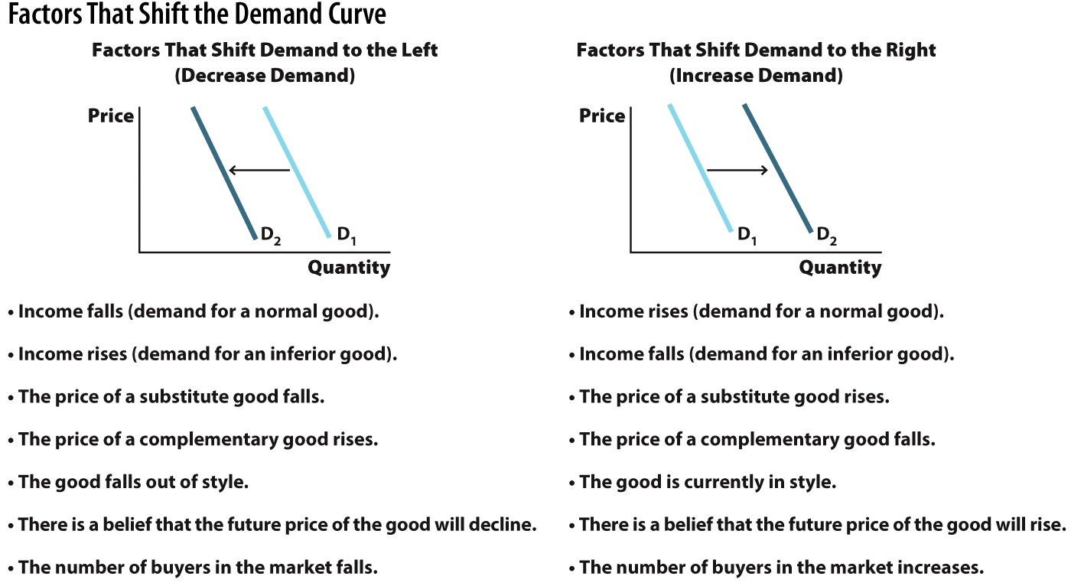
Summary of Demand Shifters
Notes:
Not all of the "negative" events are bad. For example, income rising with an inferior good, and the price of a substitute falling aren't necessarily bad.
The same can be said on the right. Not all of the "positive" events are good, such as income falling and buying more of an inferior good.

Slide 40
Class Activity: Think-Pair-Share
You work at a restaurant/bar.
Your boss comes to you, knowing you are studying economics, and asks for your opinion on the following question:
Which of the following would increase the demand for drinks the most?
Reduction in the price of a complementary good such as an appetizer.
Reduction in the price of drinks.
Both would.
Think carefully about your answer for a minute. Pair up with a classmate and share your thoughts.
Notes:
Answer:
Think about the difference between the following:
Increase in demand
Increase in quantity demanded
If you want to increase demand, you need to cause a shift in demand. This is done by reducing the price of the complement goods.
If you decrease the price of drinks, this is an increase in quantity demanded, NOT an increase in demand!

Slide 41
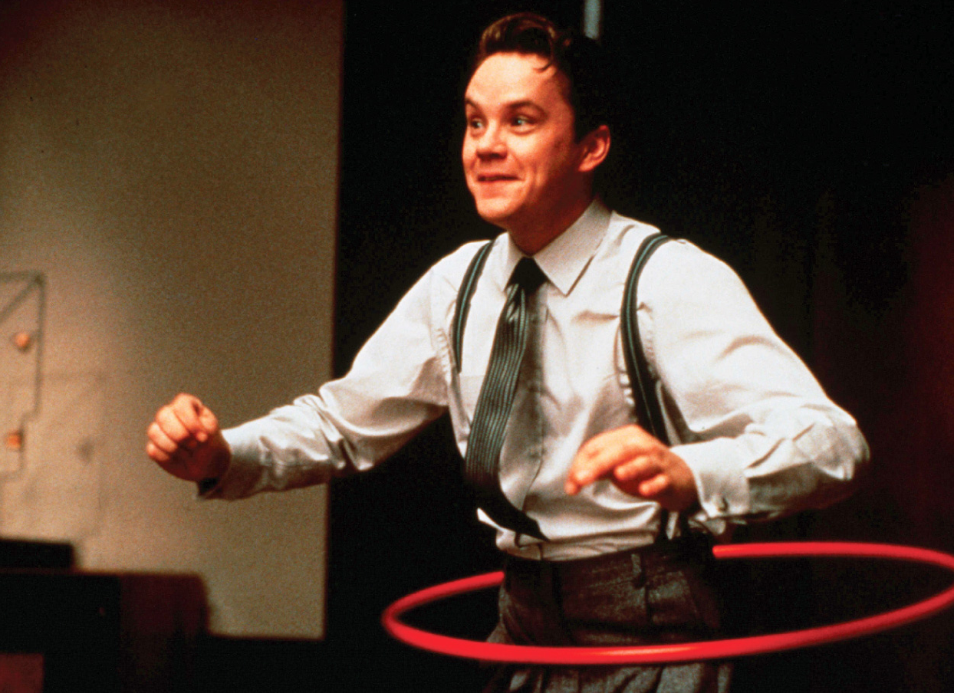
Economics in The Hudsucker Proxy
"The Hudsucker Proxy (1994)"
Watch for changes in price.
Which price changes are an illustration of a movement along a demand curve, and which are the result of demand increase?
Notes:
Economics in the Media
Lecture tip:
The clip mentioned on the slide can be found in the Interactive Instructor's Guide. Access the direct link by clicking the icon in the PowerPoint above.
Summary:
At first, the clip shows moving along a demand curve by lowering price. However, there's still no effect since the hula hoop seems to be unpopular.
Then, after a boy finds discarded hula hoops, popularity (and demand) of hula hoops increases. This causes the demand curve to keep shifting outward, resulting in higher prices.

Slide 42
Supply
Quantity supplied
The amount of the good or service that producers are willing and able to sell at the current price.
Law of supply
All other things equal, there is a direct relationship between price and quantity supplied.
Direct: two variables move in the same direction.
Notes:
Many supply topics are analogous to demand. Thus, you may not have to spend as much time teaching supply.
For supply, we can talk about the fish market again.

Slide 43
Supply
Supply schedule
Table showing the relationship between price and quantity supplied.
Supply curve
Graph of the relationship between price and quantity supplied.
Market supply
Horizontal sum of all individual quantities supplied by each seller in the market at each price.
Notes:
Analogous to demand:
There are many ways to convey information.
Supply schedule: table
Supply curve: graph
We can also use math and equations.
Market supply: this is just adding up the supply of all potential sellers of the good.

Slide 44
Supply
Pure Food Fish's Supply Schedule
Price of Salmon | Salmon Fillets Supplied
$20.00 | 800
$17.50 | 700
$15.00 | 600
$12.50 | 500
$10.00 | 400
$ 7.50 | 300
$ 5.00 | 200
$ 2.50 | 100
$ 0.00 | 0
Higher price
Higher quantity supplied
Lower quantity supplied
Lower price
Notes:
The supply schedule for salmon in the table shows how many salmon that Sol Ammon, owner of Pure Food Fish, would sell each month at different prices. When the market price is $20.00, Sol is willing to sell 800 salmon fillets. At $12.50 Sol's quantity supplied is 500. If the price falls to $10.00, he supplies 100 fewer fillets, or 400. Every time the price falls, Sol supplies less salmon. This means he is constantly adjusting the amount of salmon he offers. As the salmon prices fall, so do Sol's profits. Since Sol's livelihood depends on selling seafood, he has to find a way to compensate for the lost income. So he might offer more cod instead.
Sol, and the other seafood vendors must respond to price changes by adjusting what they offer for sale in the market. This is why Sol offers more salmon when the price of salmon rises, and less salmon when the price declines.

Slide 45
Market Supply
Price of Salmon |  | Pure Food Fish's Supply |  | City Fish's Supply |  | Market Supply
$20.00 |  | 800 |  | 200 |  | 1000
$17.50 |  | 700 |  | 175 |  | 875
$15.00 |  | 600 |  | 150 |  | 750
$12.50 |  | 500 |  | 125 |  | 625
$10.00 |  | 400 |  | 100 |  | 500
$ 7.50 |  | 300 |  | 75 |  | 375
$ 5.00 |  | 200 |  | 50 |  | 250
$ 2.50 |  | 100 |  | 25 |  | 125
$ 0.00 |  | 0 |  | 0 |  | 0
+
=
Notes:
Sol Ammon is not the only vendor selling fish at the Pike Place Market. The market supply is the sum of the quantities supplied by each seller in the market at each price. However, to make our analysis simpler, let's assume that our market consists of just two sellers, City Fish and Pure Food Fish, each of whom sells salmon.
Verbally go through a few of the rows just to show the addition.
We have added City Fish's supply to Pure Fish Food. The result is seen in the table, where we calculate the market supply in the last column, and in the figure, where their two separate supply curves are added to create the market supply curve.

Slide 46
Supply Curve
Notes:
The A supply curve is a graph of the relationship between the prices in the supply schedule and the quantity supplied at those prices. As you can see the figure, this relationship produces an upward-sloping curve. Sellers are more willing to supply the market when prices are high since this generates more profits for the business. The upward-sloping curve means that the slope of the supply curve is positive, which illustrates a direct, or positive, relationship. For instance, when the price of salmon increases from $10.00 to $12.50 per fillet, Pure Food Fish will increase the quantity it supplies to the market from 400 to 500 fillets.
The supply curve is graphed from the data in the previous table.

Slide 47
Shifts in Supply
Movement along a supply curve
Caused by a change in the price of the good.
Direct relationship between price and quantity supplied.
Shift in supply
Caused by non-price factors.
Entire supply curve will shift to the left or right.
Notes:
Just like demand, we can have a movement along a supply curve, or a shift of the entire supply curve.
A movement along a supply curve is when we have just a single supply curve, but the price of the good changes. We move from point A to point B along the same curve. We slide up and right OR down and left along the curve.
A shift occurs as the result of a change in something OTHER than the price. We will list these determinants in a little bit.

Slide 48
Market Supply

Slide 49
Supply Shifters
1. The cost of inputs
Inputs
Resources used in the production process
Inverse relationship between input costs and supply curve
2. Changes in technology
Technology
Knowledge that producers have about how to produce a product
Direct relationship between level of technology and supply
Notes:
The cost of inputs is probably the main supply shifter.
Cost of inputs:
Businesses exist to make money and when the prices of inputs—the resources used in the production process—change, so do profit margins. Inputs can take a number of forms and may include laborers, equipment, raw materials, buildings, and capital. Each of these resources is critical to the production process. If the cost of inputs declines, profit margins improve. Improved profit margins make the firm more willing to supply the good. So, for example, if Starbucks was able to purchase coffee beans at a significantly reduced price, it would be willing to supply moer coffee. Conversely, higher-input costs reduce profits. For instance, at Starbucks, store employees, or "baristas" as they are commonly called, comprise a large component of the cost. An increase in the minimum wage would require Starbucks to pay its workers more or use fewer workers. Both of these options are bad for business and could make Starbucks less willing to supply coffee.
Technology:
Technology refers to the knowledge that producers have about how to produce their products. An improvement in technology allows a producer to produce more output with the same resources. Or, to put it another way, an improvement in technology allows the producer to produce a given level of output with fewer resources. For example, if a new espresso machine works twice as fast as the old technology, Starbucks could serve its customers more quickly, reduce the often long lines, and increase the number of sales it makes. As a result, Starbucks would be willing to produce and sell more espresso at each price. In other words, if the producers of a good discover a new and improved technology, or a better production process, there would be an increase in supply; the supply curve for the good would shift to the right.

Slide 50
Supply Shifters
3. Taxes and subsidies
Tax
Tax paid by producer → added cost of production
Inverse relationship between taxes and supply
Subsidy
"Opposite" of a tax; government pays sellers to produce goods.
Direct relationship between subsidies and supply
Notes:
If the producer has to pay a tax on the good that it is producing and selling, this payment to the government becomes an added cost of production. One example is the cigarette tax. The presence of the cigarette tax on tobacco companies adds to the overall cost of production and will cause a loss of profit. So placing a tax on the producer's good will cause a decrease in the willingness to supply the good. The reverse is true for a subsidy, which is a payment to the producer to encourage production. Subsidies act to reduce the firm's costs. Some examples of subsidies are payments made to farmers, the construction of new stadiums to entice professional sports teams to locate in a particular city, and subsidies to encourage the production of certain types of energy. Providing a subsidy to the producer of a good will increase the available supply of the good. College education is a particularly good example. Many state universities, colleges, and two-year institutions receive government appropriations, or subsidies, to reduce the cost of tuition to students. As a result, subsidies have made many colleges more accessible and affordable.

Slide 51
Supply Shifters
4. Number of sellers
Recall the market supply curve
More individual sellers means more market supply.
5. Price expectations
Higher price expected tomorrow? If so, delay sales until future, if possible.
Inverse relationship between tomorrow's expected price and today's supply
Notes:
Lecture notes:
#4 is pretty self-explanatory. Similar to the market demand. In this case with supply, if there are more sellers, there is more market supply.
#5 (from text):
A seller who expects a higher price for the product in the future may wish to delay sales until a time in the future when it will bring a higher price. For instance, florists know that the demand for roses spikes on Valentine's Day and Mother's Day. In order to be able to sell more flowers during the times of peak demand, when they can charge substantially higher prices, many florists work later and hire temporary workers to make deliveries in order to increase their ability to supply flowers while the price is high. Likewise, the expectation of lower prices in the future will cause sellers to offer more for sale now. This is particularly noticeable in the electronics sector where newer—and much better—products are constantly being developed and released. Sellers know that their current offerings will soon be replaced by something better, and consumer demand for the existing technology will plummet. This means that prices typically fall the longer a product is on the market. Since producers know that the price will fall over time, they supply as many of the new models as possible before the next wave of innovation cuts the price that they can charge.

Slide 52
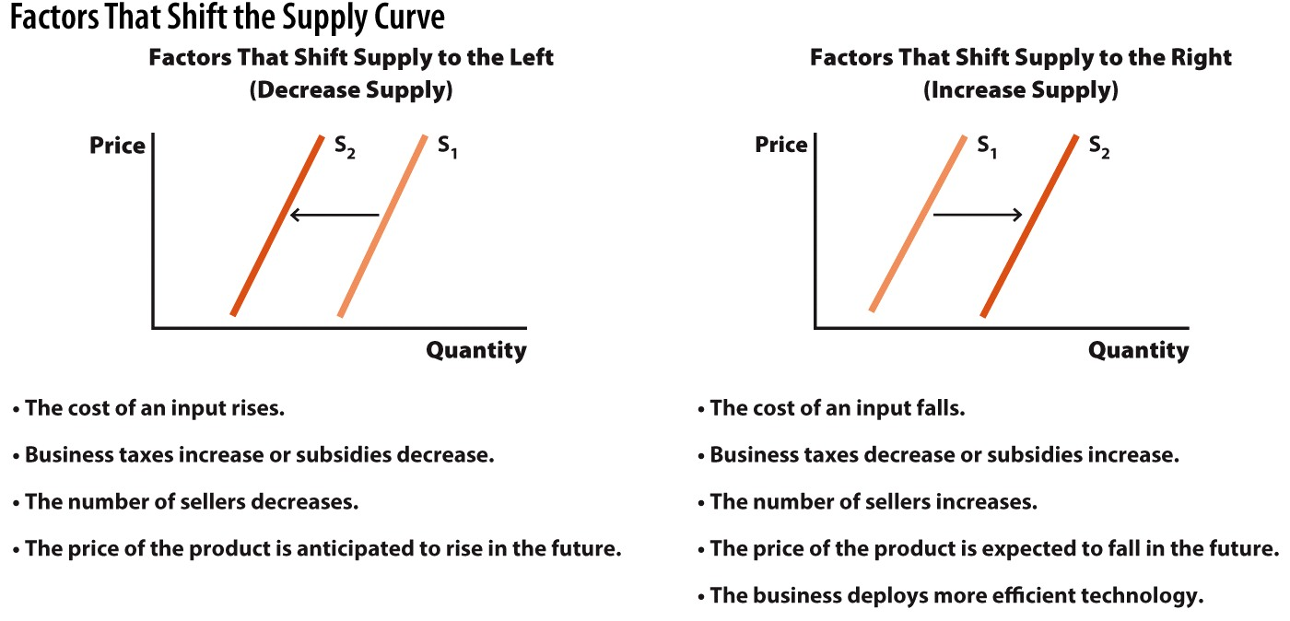
Summary of Supply Shifters

Slide 53
Practice What You Know
Assume the price of cheese decreases. What will happen in the pizza market?
The supply of pizza increases.
The supply of pizza decreases.
The quantity supplied of pizza increases.
The quantity supplied of pizza decreases.
Notes:
Cheese is an INPUT in making pizza. If input costs of pizza go up, the supply of pizza decreases.

Slide 54
Practice What You Know
Which of the following will cause the supply curve for oranges to shift to the left?
The government begins subsidizing orange growers.
A study showing oranges improve eyesight.
Ice storm strikes Florida.
A new orange juice commercial airs on TV.
Notes:
An ice storm will decrease the number of firms supplying oranges. It may destroy most of their crop.
Answers B and D will increase DEMAND for oranges.

Slide 55
Bringing Supply and Demand Together
How is the price of a good determined?
The market forces of supply AND demand work simultaneously to determine the price.
The law of supply and demand
The price of any good will adjust to bring the quantity supplied and quantity demanded into balance.
Notes:
We have examined supply and demand separately. Now it is time to see how the two interact. The real power and potential of supply and demand analysis is how it predicts prices and output in the entire market.
Think about a scissors cutting a piece of paper. Which blade does the cutting? Both blades work together to cut the paper.

Slide 56
Supply and Demand
Equilibrium point
Graphically, the intersection of supply and demand
Equilibrium price
The price that causes quantity supplied to equal quantity demanded.
The price that "clears the market"
Equilibrium quantity
The numerical quantity (supplied and demanded) at the equilibrium price
Notes:
In economics, important points on graphs usually occur at intersections or points of tangency.
The equilibrium price and quantity are sometimes labeled on the graph as P* and Q*, respectively.

Slide 57
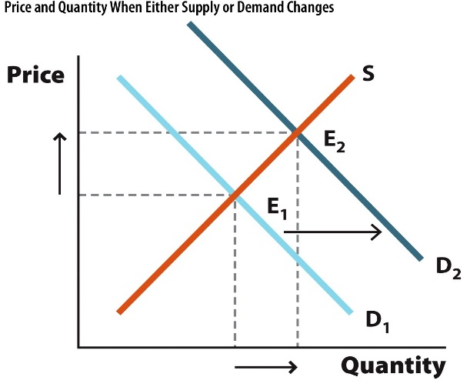
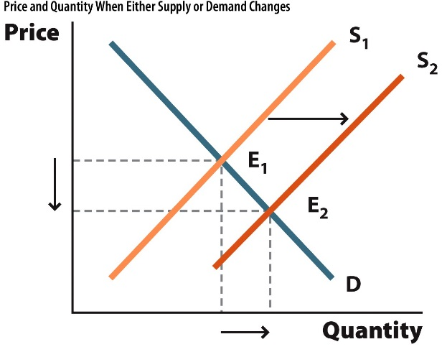
Graphs of Shifts
Change | Illustration | Impact on Price and Quantity
Demand increases |  | The demand curve shifts to the right. As a result, the equilibrium price and equilibrium quantity increase.
Supply increases |  | The supply curve shifts to the right. As a result, the equilibrium price declines and the equilibrium quantity increases.

Slide 58
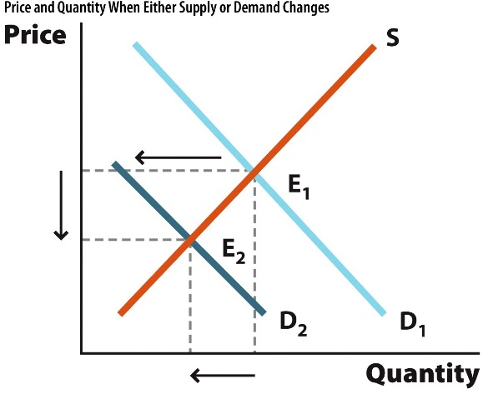
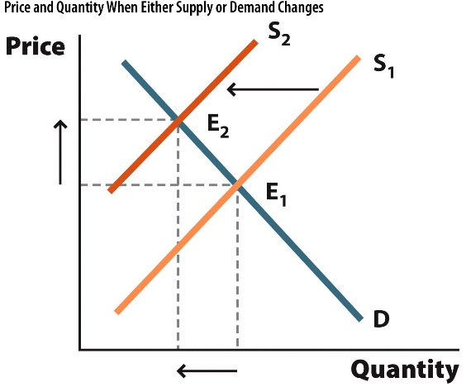
Graphs of Shifts
Change | Illustration | Impact on Price and Quantity
Demand decreases |  | The demand curve shifts to the left. As a result, the equilibrium price and equilibrium quantity decrease.
Supply decreases |  | The supply curve shifts to the left. As a result, the equilibrium price increases and the equilibrium quantity decreases.

Slide 59
Shifts in Supply and Demand: Example
By itself, decrease in supply leads to
Higher equilibrium price.
Lower equilibrium quantity.
By itself, increase in demand leads to
Higher equilibrium price.
Higher equilibrium quantity.
Combined effects?
Higher equilibrium price
Equilibrium quantity?

Slide 60
Shifts in Supply and Demand
The world is complex and shifts don't always occur in a simple, one-at-a-time manner.
What happens if there is a shift in supply AND a shift in demand?
Notes:
As with any analysis, the best answer is to graph the problem, and analyze our graph!

Slide 61
Shifts in Supply and Demand: Example
Consider the market for salmon, and suppose two things happen simultaneously:
A major drought hits the northwest United States
A medical journal reports that people who consume salmon live longer than people who eat other fish
These two events will respectively lead to:
A decrease in the supply of salmon.
An increase in the demand for salmon.

Slide 62
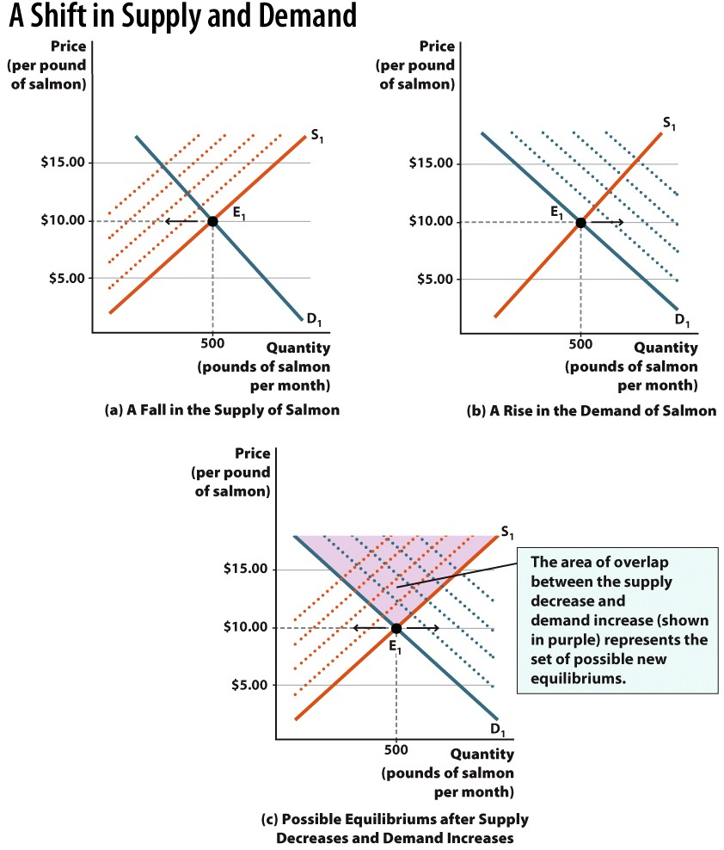
Notes:
When supply and demand both shift, the resulting equilibrium can no longer be identified as an exact point. This is seen in (c), which combines the supply shift in (a) with the demand shift in (b). When supply decreases and demand increases, the result is that the price must rise, but the equilibrium quantity can either rise or fall.

Slide 63
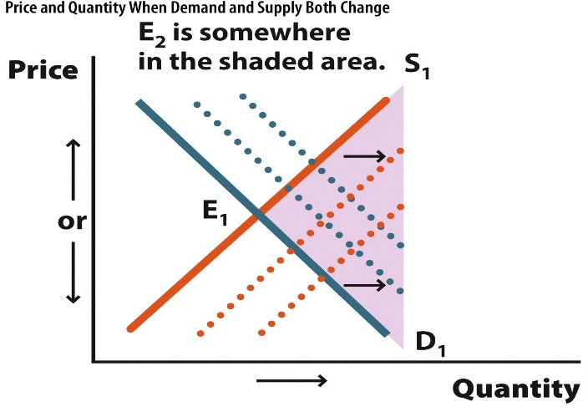
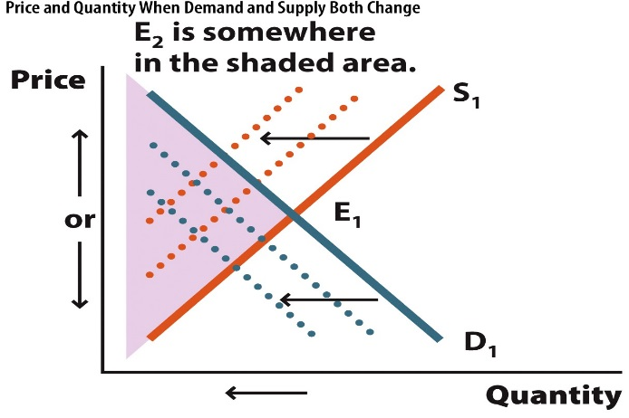
Graphs of Shifts
Change | Illustration | Impact on price and quantity
Demand and supply both increase |  | The demand and supply curves shift to the right. The shifts reinforce each other with respect to quantity, but act as countervailing forces along the price axis.
Demand and supply both decrease |  | The demand and supply curves shift to the left. The shifts reinforce each other with respect to quantity, but act as countervailing forces along the price axis.

Slide 64
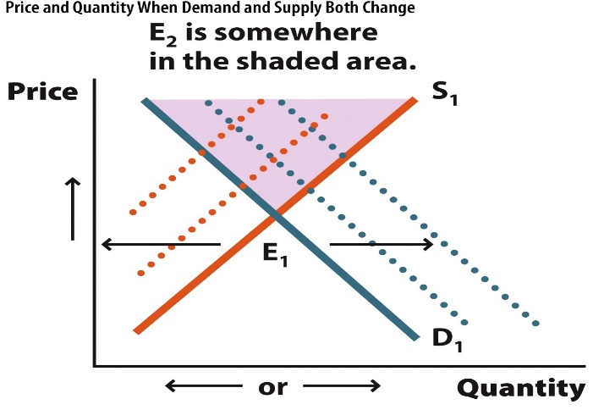
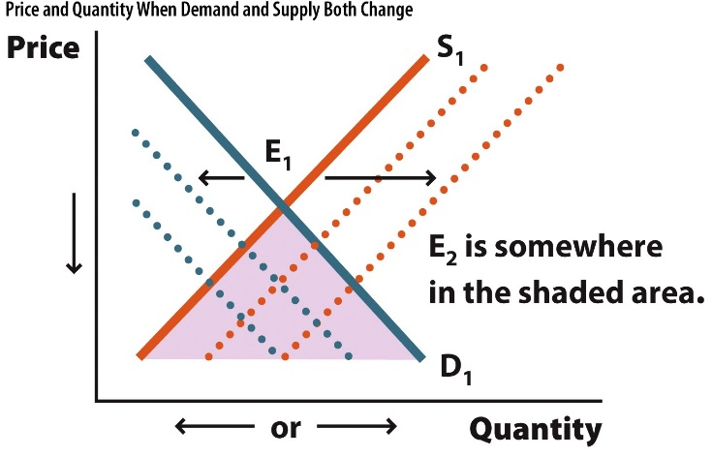
Graphs of Shifts
Change | Illustration | Impact on price and quantity
Demand increases and supply decreases |  | The demand curve shifts to the right and the supply curve shifts to the left. The shifts reinforce each other with respect to price, but act as countervailing forces along the quantity axis.
Demand decreases and supply increases |  | The demand curve shifts to the left and the supply curve shifts to the right. The shifts reinforce each other with respect to price, but act as countervailing forces along the quantity axis.

Slide 65
Shorthand Summary of Shifts
D→ : P↑Q↑
D← : P↓Q↓
S→ : P↓Q↑
S← : P↑Q↓
D→ & S→ : P(↑↓ or ↔)Q↑
D← & S← : P(↑↓ or ↔)Q↓
D→ & S← : P↑Q(↑↓ or ↔)
D← & S→ : P↓Q(↑↓ or ↔)
→ Indicates right shift.
← Indicates left shift.
Notation: ↔ means "stays the same"

Slide 66
Shift Summary
Don't memorize the previous slide!
A better idea:
Figure out what shift(s) will occur as a result of some economic event.
Draw the correct shift(s).
Examine what you just graphed.

Slide 67
Economics in Willy Wonka & The Chocolate Factory
"Willy Wonka & The Chocolate Factory"
What sort of market effect is happening here?
Why is the price of candy bars increasing?
Notes:
"Economics in the Media" Slide
Lecture tip:
The clip mentioned on the slide can be found in the Interactive Instructor's Guide. Access the direct link by clicking the icon in the PowerPoint.

Slide 68
Shortages and Surpluses
Shortage
Q_{D} > Q_{S}
Occurs at any price below equilibrium.
Price will rise over time toward equilibrium if the market is not regulated!
Why does price rise over time with a shortage?
Consumers who value the product will "outbid" other consumers or otherwise show a higher willingness to pay.
Suppliers will see that the price can be raised without a decrease in sales.
Notes:
Q_{D} = quantity demanded
Q_{S} = quantity supplied
Shorthand like this will speed up note taking.
Shortage: not all consumers get to buy what they want.
Surplus: too much, the firm has leftovers it wants to sell, but can't
Price rises over time with a shortage. Why?
Consumers may bid prices upward if they are desperate to purchase the good.
Think of an auction

Slide 69
Shortages and Surpluses
Surplus
Q_{S} > Q_{D}
Occurs at any price above equilibrium.
Price will fall over time toward equilibrium if the market is not regulated!
Why does price fall over time with a surplus?
Firms will have to eventually get rid of mounting inventories of goods.
To do this, they must lower their prices.
Notes:
Q_{D} = quantity demanded
Q_{S} = quantity supplied
Shorthand like this will speed up note taking.
Shortage: not all consumers get to buy what they want.
Surplus: too much, the firm has leftovers it wants to sell, but can't.
Price falls over time with a surplus. Why?
Producers need to unload mounting inventories. To do this, the price must be lowered.

Slide 70
Shortages and Surpluses
Notes:
In the figure, we can see that when the price of salmon fillets is $10, consumers demand 500 fillets and producers supply 500 fillets. This is represented graphically at the point E, known as the equilibrium point, where the demand curve and the supply curve intersect. At this point, the two opposing forces of supply and demand are perfectly balanced.
Equilibrium:
Notice that there is only one price, $10, at which the quantity demanded equals the quantity supplied. At this price, all the fillets that sellers in the market supply are sold. Every buyer is able to find a salmon fillet, and every producer is able to sell his entire stock of fillets. When this is the case, we say that $10 is the equilibrium price, where the quantity supplied equals the quantity demanded. The equilibrium price is also called the "market-clearing price," since this is the only price where no surplus or shortage of the good exists. Similarly, there is also an equilibrium quantity, of 500 fillets, where the quantity supplied equals the quantity demanded. When the market is in equilibrium, we sometimes say that "the market clears," or that "the price clears the market." The equilibrium has a special place in economics because movements away from that point throw the market out of balance. The equilibrium process is so powerful that it is often referred to as the law of supply and demand. According to the law of supply and demand, market prices adjust to bring the quantity supplied and quantity demanded into balance.
Shortage:
At any price below the equilibrium price of $10, we will have a situation where Qd > Qs, referred to as a shortage. In this case, at a price of $5, Qd (at point B) is 750 and Qs (at point A) is 250. The difference between 750 and 250 is 500, meaning that at a price of $5, consumers want to buy 500 more pounds of the good than suppliers are willing to sell. This is the shortage.
Surplus:
At any price above the equilibrium price of $10, we will have a situation where Qs > Qd, referred to as a surplus. In this case, at a price of $15, Qs (at point F) is 750 and Qd (at point C) is 250. The difference between 750 and 250 is 500, meaning that at a price of $15, suppliers want to sell 500 more pounds of the good than consumers are willing to buy. This is the surplus.

Slide 71
Economics in Pawn Stars
"Pawn Stars" (History Channel)
Bartering is a great way to see the forces of supply and demand at work.
Notes:
"Economics in the Media" Slide
Lecture tip:
The clip mentioned on the slide can be found in the Interactive Instructor's Guide. Access the direct link by clicking the icon in the PowerPoint above.

Slide 72
Conclusion
If you take away just one thing from this course, it will probably be "supply and demand."
In competitive markets, supply and demand allow prices to adjust toward equilibrium.
In equilibrium, the markets clears. This means there are no surpluses or shortages.

Slide 73
Summary
Supply and demand play a key role in determining prices in the market economy. Prices established through this process help allocate resources.
A market consists of a group of buyers and sellers for a particular product or service.
The demand curve is downward-sloping.
The supply curve is upward-sloping.

Slide 74
Summary
A change in the price of a good will cause
A movement along the demand curve.
A movement along the supply curve.
Changes other than price
Cause a shift in demand.
Cause a shift in supply.
Supply and demand interact through the process of market coordination.
The equilibrium is the balancing point between the two opposing forces. The market clearing price and output are determined at the equilibrium point.
Shortages and surpluses are resolved in competitive markets.

Slide 75
Practice What You Know
Suppose the price of good X increases. In terms of demand, what is the result?
The demand for X increases.
The demand for X decreases.
The quantity demanded of X increases.
The quantity demanded of X decreases.
Notes:
Correct answer: D
This is a movement up and left along a demand curve. Price is on the vertical axis, and quantity demanded is on the horizontal axis.

Slide 76
Practice What You Know
Suppose goods X and Y are substitutes for each other. If the price of good Y increases, what is the result in the market for good X?
The demand for X increases.
The demand for X decreases.
The quantity demanded of X increases.
The quantity demanded of X decreases.
Notes:
Correct answer: A
This is a rightward shift in the demand for X. People want to buy more X, even though the price of X didn't change.

Slide 77
Practice What You Know
Suppose there is a shortage in the market for avocados. Assuming a competitive and unrestrained market, what happens over time?
The price of avocados will fall, and the shortage will worsen.
The price of avocados will rise, and the market will eventually reach equilibrium.
The price of avocados will rise, and a large surplus will be created.
Producers will stop growing avocados.
Notes:
Correct answer: B
Without price controls, the market will "correct" itself and move toward equilibrium. A shortage is due to the price being too low. The price will rise to correct the shortage.

Slide 78
Practice What You Know
Consider the market for bananas. Suppose that both the supply and demand for bananas increases simultaneously. Which of these effects is certain?
The equilibrium price of bananas will increase.
The equilibrium price of bananas will decrease.
The equilibrium quantity of bananas will increase.
The equilibrium quantity of bananas will decrease.
Notes:
Correct answer: C
Supply increase will cause Q increase and P decrease.
Demand increase will cause Q increase and P increase.
The P effect is uncertain.
The Q effect is definitely an increase.

Slide 79
Sources
"Principles of Economics with Smartwork Access (ISBN: 978-0-26314-5), 1st Edition, 2013" by Mateer and Coppock
"Economics: Custom Edition for NCSU (ISBN: 9781937435202" by David Hyman

